Slide 1
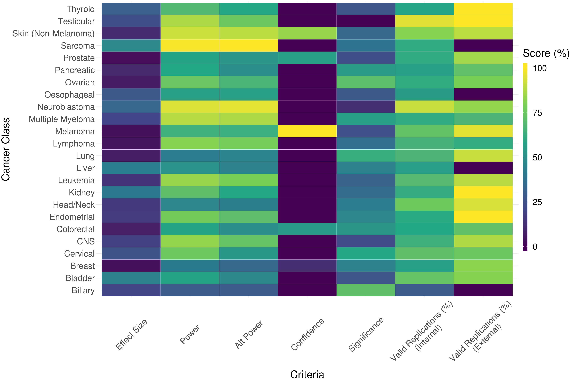
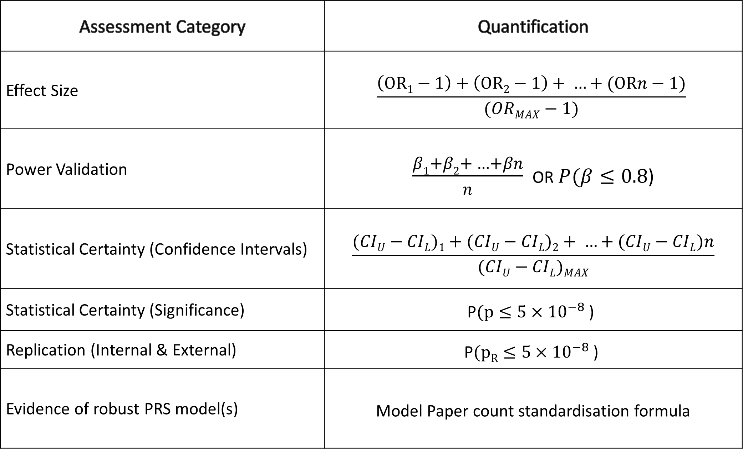
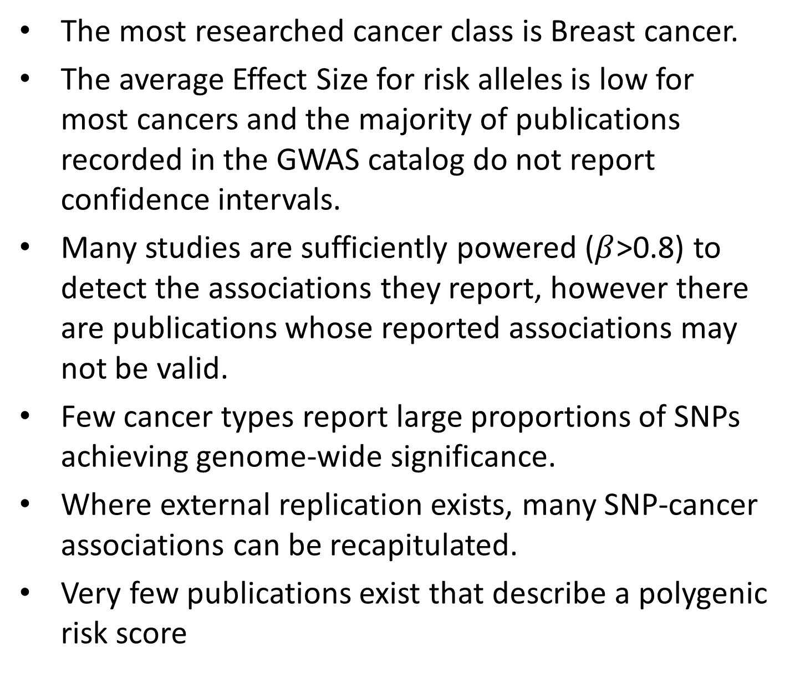
What’s a clinician gotta do to get a Polygenic Risk Score Around Here?
James A. Morgan¹, Paul A. James^{1,2,3}
¹The Parkville Familial Cancer Centre, Peter MacCallum Cancer Centre and The Royal Melbourne Hospital, Melbourne, Victoria, Australia, 3000,
²Cancer Genetics Laboratory, Peter MacCallum Cancer Centre, Melbourne, Victoria 3000, Australia,
³Sir Peter MacCallum Department of Oncology, The University of Melbourne, Parkville, Victoria 3010, Australia,
Summary
Generating the Readiness Matrix
Compared to existing methods, Polygenic Risk Score (PRS) Assessment offers the potential for a more precise, reliable and personalised mechanism for determining an individual’s cancer risk.
To identify PRS-assessable malignancies, we conducted a literature search including the NHGRI-EBI catalog of Genome Wide Association Studies (GWAS’) to identify Single Nucleotide Polymorphisms (SNPs) with described cancer associations.
We examined the methods used to derive each reported association, the underlying power to detect it, as well as evidence of validation and recapitulation of the result. The body of the text was used to derive criteria by which the validity of a reported association can be assessed for incorporation into a combined PRS for each cancer stream.
Evidence supporting the polygenic component of risk varies greatly among cancer types. Some malignancies (eg: Breast, Colorectal and Prostate) have been the subject of many well-powered high-quality publications, including research demonstrating PRS performance. Other malignancies (eg: Cervical, Thyroid and Blood) have few reported GWAS’ and few or no studies assessing the performance of PRS models.
Here, we provide a comparative ranking of the development of the field across cancer types.
Assessment Category | Quantification
Effect Size | $$\frac{\left(OR1−1\right)+\left(OR2−1\right)+ …+(ORn−1)}{(ORMAX−1)}$$
Power Validation | $\frac{β1+β2+ …+βn}{n}$ OR $P(β≤0.8\text{)}$
Statistical Certainty (Confidence Intervals) | $$\frac{(CIU−CIL)1+(CIU−CIL)2+ …+(CIU−CIL)n}{(CIU−CIL)MAX}$$
Statistical Certainty (Significance) | $$\text{P}(p≤5{×10}^{−8}\text{)}$$
Replication (Internal & External) | $$\text{P}(pR≤5{×10}^{−8}\text{)}$$
Evidence of robust PRS model(s) | Model Paper count standardisation formula
Readiness Matrix: Associations from the GWAS catalog
Table 1: Readiness Formulae – Methodology for the calculations used to generate scores reported in Figure 1
Results
The most researched cancer class is Breast cancer.
The average Effect Size for risk alleles is low for most cancers and the majority of publications recorded in the GWAS catalog do not report confidence intervals.
Many studies are sufficiently powered ($β$>0.8) to detect the associations they report, however there are publications whose reported associations may not be valid.
Few cancer types report large proportions of SNPs achieving genome-wide significance.
Where external replication exists, many SNP-cancer associations can be recapitulated.
Very few publications exist that describe a polygenic risk score
Further research is required to bring the majority of cancer streams to readiness for PRS assessment.
Figure 1: Readiness Matrix reporting summary criteria for each cancer class identified in the GWAS catalog, as quantified by assessments of standardised characteristics for reported SNP-cancer associations including: Effect Size, Discovery power, Confidence, Significance, as well as proportion of replications that reported associations achieving genome wide significance.
Methods
An up-to-date version of the GWAS Catalog was cloned and filtered to retain only those records reporting SNP-cancer associations. The remaining records were classified by cancer type.
Stream-readiness is quantified through the construction of a readiness matrix (Fig 1) assessing the following:
SNP Validation: Streams gained points for each reported association for which a simple logistic regression analysis would be appropriately powered to detect the reported odds ratio.
SNP Weighting: Valid association scores were weighted based on statistical certainty (Table 1). i.e. Associations with tight confidence interval spans not crossing the null effect value carried more weight than those with a wide interval that included the null value. Similarly, replicated associations were weighted based on the proportion of replications reporting a valid association.
Existing applications: The body of available research demonstrating the performance of polygenic risk models was quantified by identifying papers through per-class literature searches.
REFERENCES
References available at: https://tinyurl.com/PRS-Poster-refs
Poster image available at: https://tinyurl.com/PRS-Poster-image
Figure 2: Barplot indicating the number of unique SNP-cancer associations per cancer class, as reported in the GWAS catalog.

